Slide 1

DANNY’s diner analysis
Olutola Adunoluwa
Pitch

Slide 2

Introduction
At Contoso, we empower businesses to foster collaborative thinking to further drive workplace innovation. By closing the loop on restaurant management, we help businesses streamline their point-of-sale experience. ​
Dann

Slide 3

Our competition
Comp
Contoso
competitors
Our product is priced below that of other restaurant industry tools on the market​
Simple and easy to use product, compared to the complex tools of the competitors​
Affordability is the main draw for our consumers to our product​
Company A​ Product is more expensive​
Companies B & C ​ Product is expensive and inconvenient to use​
Companies D & E​ Product is affordable, but inconvenient to use

Slide 4

Problem
Market gap
Customers
Financials
Restaurants need new software solutions but are using old or outdated tools and services​
10% increase of POS efficiency prove that there’s a market for simpler POS tools​
New restaurant tools increased profits by $20 million in 2019 ​
Costs
Usability
Loss of potential income by not offering new tools for restaurant workers ​
Service industry professionals want something that’s easy to adopt and simple to use for their restaurant​

Slide 5
Solution
Solution
Close the gap
Target audience
Cost savings
Easy to use
Our product makes restaurant management easier, and no other product on the market offers the same benefits​
Restaurant managers
Reduce costs for client by helping restaurants gauge their inventory and reservations ​
A simple product that gives restaurants the information they need in order to make informed staffing decisions ​

Slide 6

Product overview
Unique
First to market
Only product specifically dedicated to the restaurant industry
First beautifully designed product that's both stylish and functional​
Tested
Authentic
Conducted testing with restaurants in the area
Designed with the help and input of restaurant and service workers in the field ​

Slide 7

Product benefits
Benefit
Simple and efficient to use​
Quick customer service assistance​
Free 90-day customer service phone number​

Slide 8
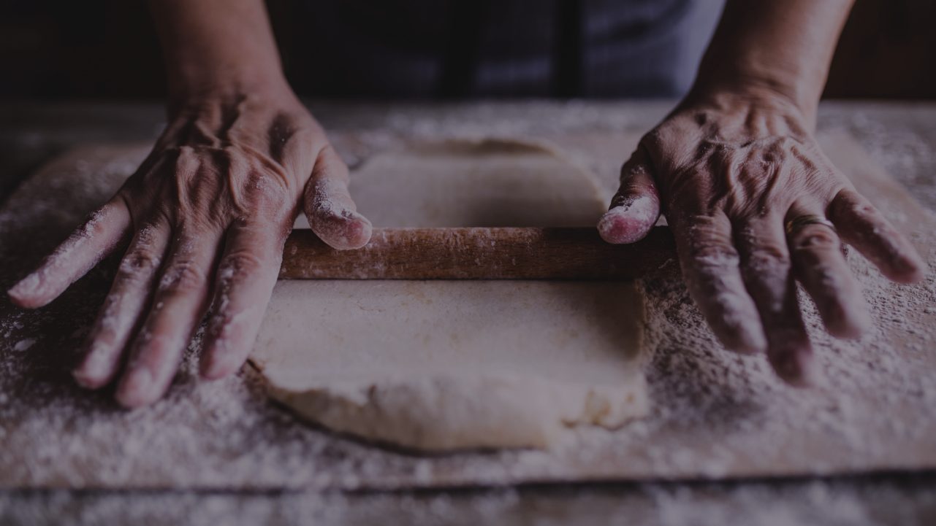
QUESTION 1
Questions

Slide 9

Business model
research​
We based our research on market trends and data from over 1,000 restaurants​
abstract
We believe managers need new industry tools to help run their restaurants​
Business
design
Minimalist design and easy to use ​

Slide 10
Market overview
Market
$3B
$2b
$1b
Opportunity to build​
Fully inclusive market​
Total addressable market​
Freedom to invent​
Selectively inclusive market​
Serviceable available market​
Few competitors​
Specifically targeted market​
Serviceable obtainable market​

Slide 11
Market comparison
$3B
$2B
$1B
Opportunity to build​
Freedom to invent​
Few competitors​
Addressable market​
Serviceable market​
Obtainable market​

Slide 12
competition
convenient
Contoso
A
Expensive​
Affordable
B
D
E
C
Inconvenient​

Slide 13
Growth Strategy
How we’ll scale in the future​
Feb
20xx
May
20xx
Oct
20xx
Roll out product to local restaurants to help establish the product​
Release the product to the regional businesses and monitor stock trends in the restaurant industry​
Gather feedback from the restaurant community to expand availability of the product​

Slide 14
Traction
Forecasting for success​
Key metrics
Revenue by year​
 | clients | orders | Gross avenue | Net revenue
20XX​ | 10​ | 1100​ | $10,000​ | $7,000​
20XX​ | 20​ | 200​ | $20,000​ | $16,000​
20XX​ | 30​ | 300​ | $30,000​ | $25,000​
20XX​ | 40​ | 400​ | $40,000​ | $30,000

Slide 15
2-Year action plan
Supply volunteers​
Run focus groups​
Gather feedback​
20XX
Jan
Feb
Mar
Apr
May
Jun
Jul
Aug
Sep
Oct
Nov
Dec
Test with restaurants​
Regional launch​
Deliver to consumers​
20XX
Jan
Feb
Mar
Apr
May
Jun
Jul
Aug
Sep
Oct
Nov
Dec

Slide 16

Financials
 | Year 1 | Year 2 | year 3
Income |  |  |  | ​
Users​ | 50,000​ | 400,000​ | 1,600,000​ | ​
Sales​ | 500,000​ | 4,000,000​ | 16,000,000​ | ​
Average Price per Sale​ | 75​ | 80​ | 90​ | ​
Revenue @ 15%​ | 5,625,000​ | 48,000,000​ | 216,000,000​ | ​
Gross Profit​ | 5,625,000​ | 48,000,000​ | 216,000,000​ | ​
Expenses​ | ​ | ​ | ​ | ​
Sales & Marketing​ | 5,062,500​ | 38,400,000​ | 151,200,000​ | 70%​
Customer Service​ | 1,687,500​ | 9,600,000​ | 21,600,000​ | 10%​
Product Development​ | 562,500​ | 2,400,000​ | 10,800,000​ | 5%​
Research​ | 281,250​ | 2,400,000​ | 4,320,000​ | 2%
Total Expenses​ | 7,593,750 | 52,800,000 | 187,920,000

Slide 17




Meet the team
Team
Takuma Hayashi​​
Mirjam Nilsson​
Flora Berggren​​
Rajesh Santoshi​​
President​
Chief Executive Officer
Chief Operations Officer
VP Marketing

Slide 18








The full team
Takuma Hayashi​
Mirjam Nilsson​​
Flora Berggren​​
Rajesh Santoshi​​
President​
Chief Executive Officer​
Chief Operations Officer​
VP Marketing​
Graham Barnes​
Rowan Murphy​
Elizabeth Moore​
Robin Kline​
SEO Strategist​
Product Designer​
Content Developer​
team

Slide 19
Funding
$12K
$14K
$32K
$82K
Retail sales​
Angel investments​
Cash​
Shares​
Revenue obtained from restaurant online market ​
Amount obtained through other investors​
Liquid cash we have on hand​
Number of shares converted into USD​

Slide 20

Summary
At Contoso, we believe in giving 110%. By improving the tools of restaurant management, we help businesses streamline their point-of-sale experience. We thrive because of our market knowledge and a great team behind our product. As our CEO says, "Efficiencies will come from proactively transforming how we do business."​
Sum

Slide 21

Thank You
Mirjam Nilsson​​
206-555-0146​
mirjam@contoso.com​
www.contoso.com​
Than

